Slide 1

Data Management PROJECT (INT217) DATA analysis of IPL 2008-19
Submitted by :
Raman Singh
11806069
B Tech CSE

Slide 2
INTRODUCTION
IPL - Indian Premier League is one of the most successful formats of games in recent times. It brought a new sense of gaming among the cricket fans rather I would say a revolution where in it raked millions of rupees and lot of companies have agreed to sponsor in the future as well. This game was different than others.

Slide 3
Objectives:
1. To find the team that won the most number of matches year wise.
2. Does winning toss increases the chances of victory.
3. To find the player with the most player of the match awards.
4. To find the city that hosted the maximum number of IPL matches.
5. To find the most winning team for each year.
6. To find performance of players on different stadium.
7. To find performance of players in different teams.

Slide 4
This project will help :
To get good experience in using excel..
To use pivot table.
Learn to make dashboard.
To make different types of graph.
To use tableau for cleaning of data.

Slide 5
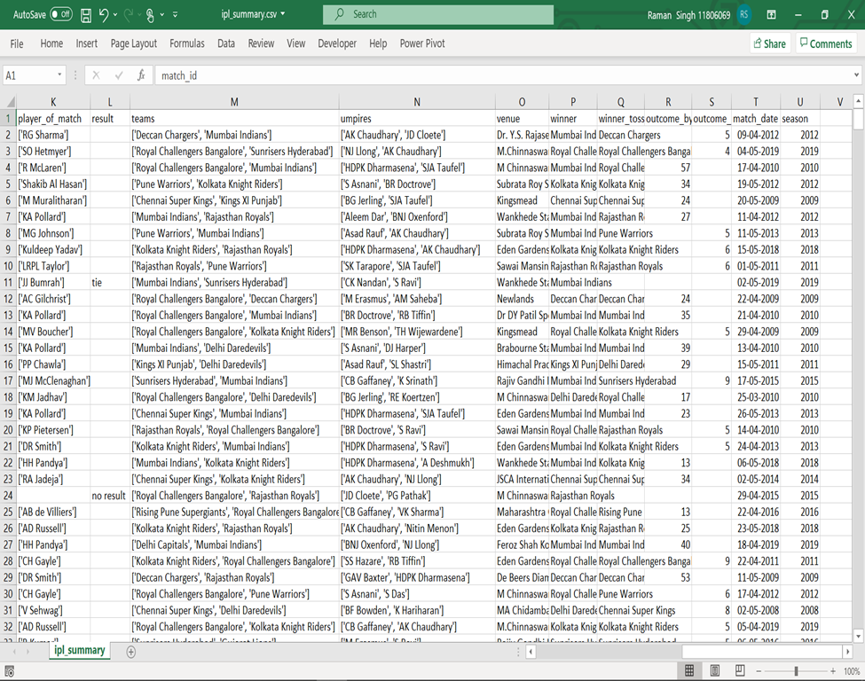
ETL PROCESS: ETL-EXTRACT, TRANSFORMATION, LOAD

Slide 6
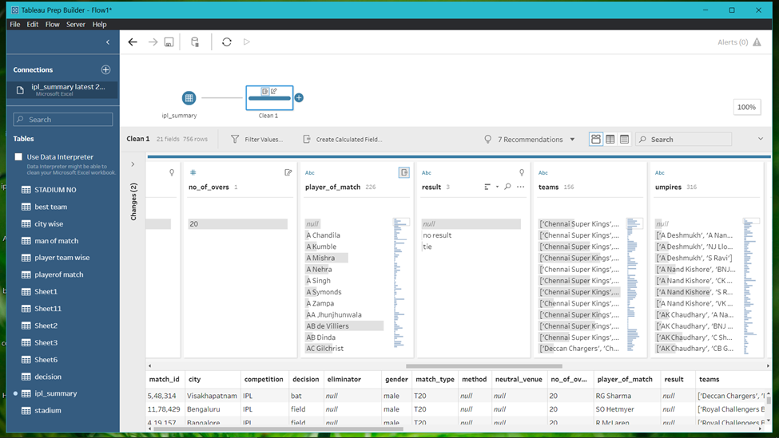

Slide 7
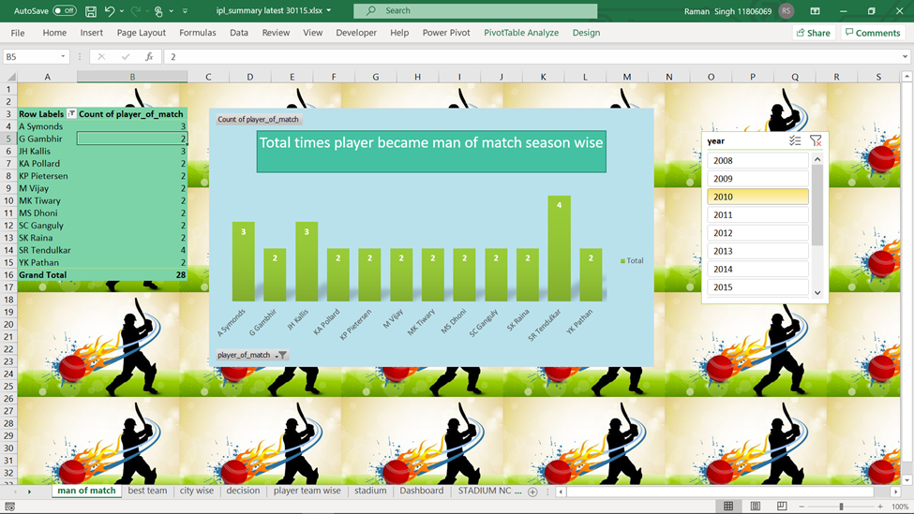
Analysis Results & Visualisation:

Slide 8
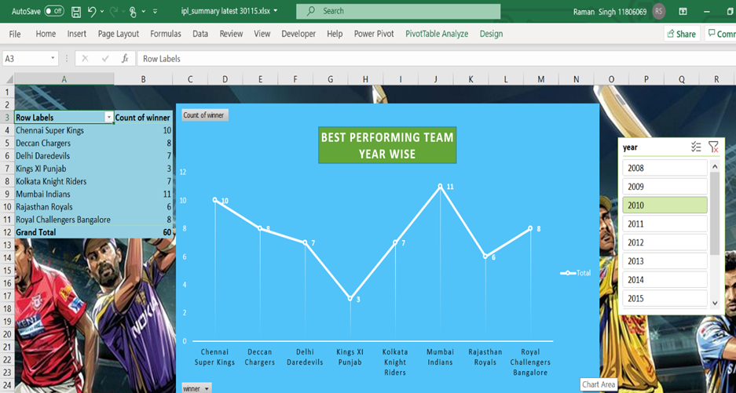

Slide 9
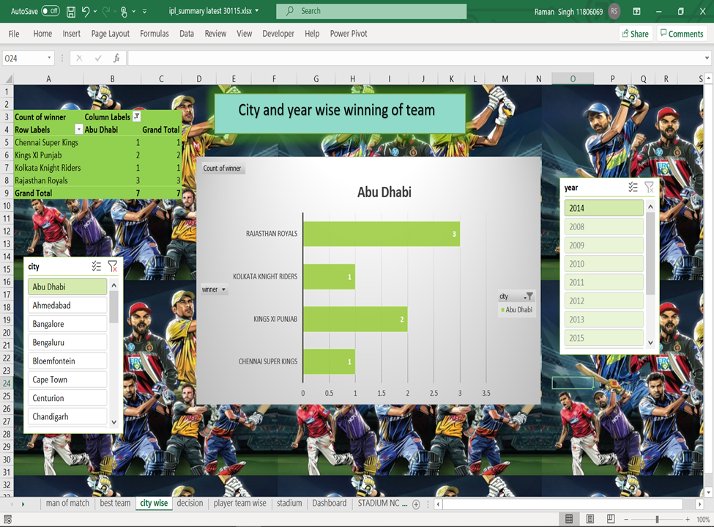

Slide 10
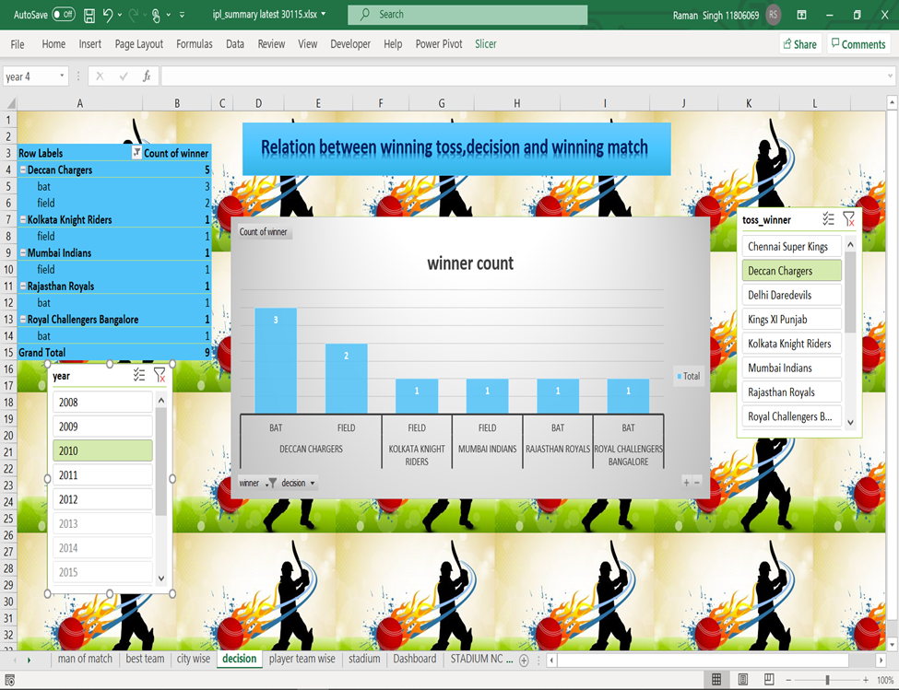

Slide 11
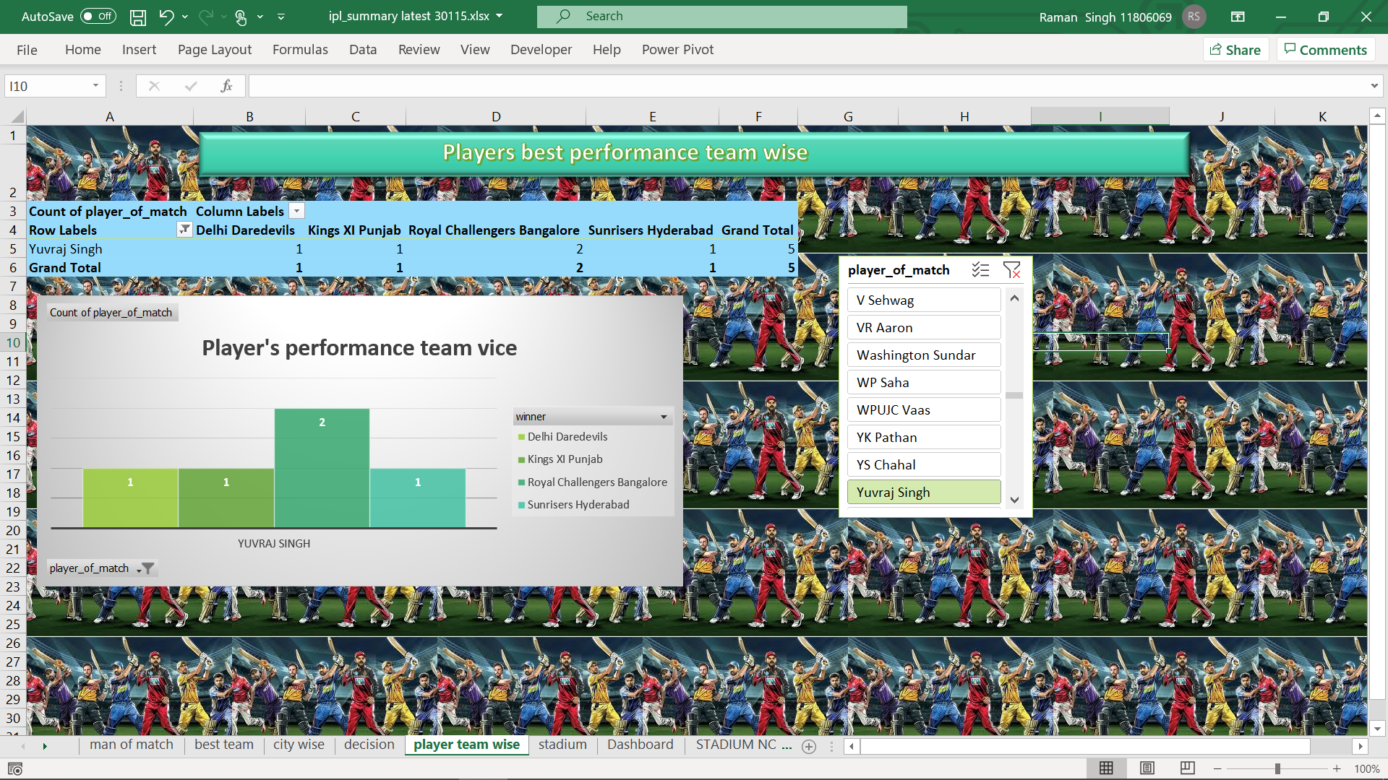

Slide 12
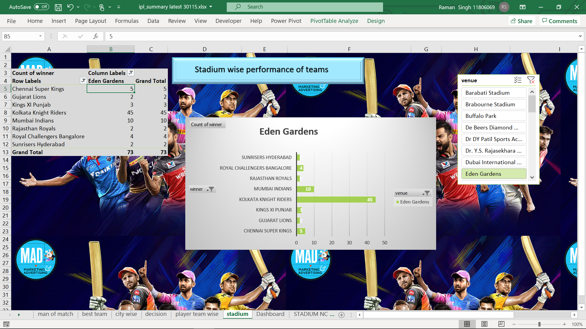

Slide 13
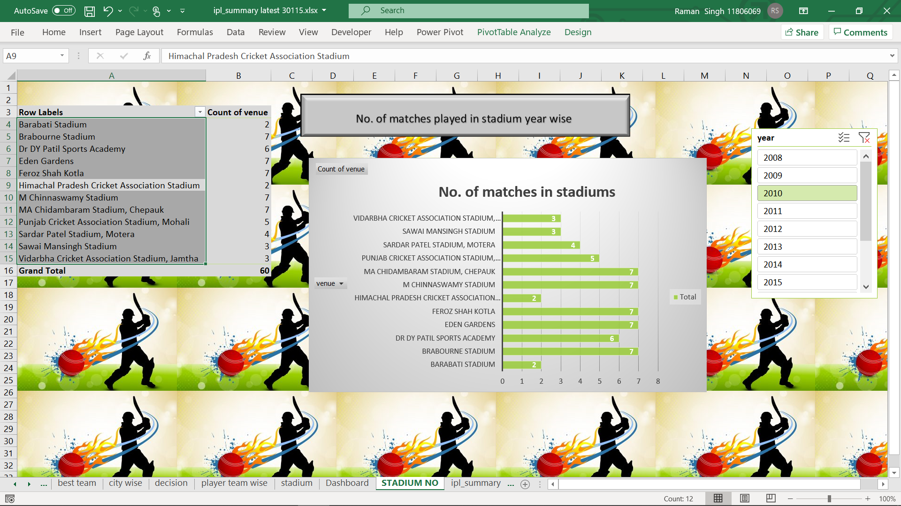

Slide 14
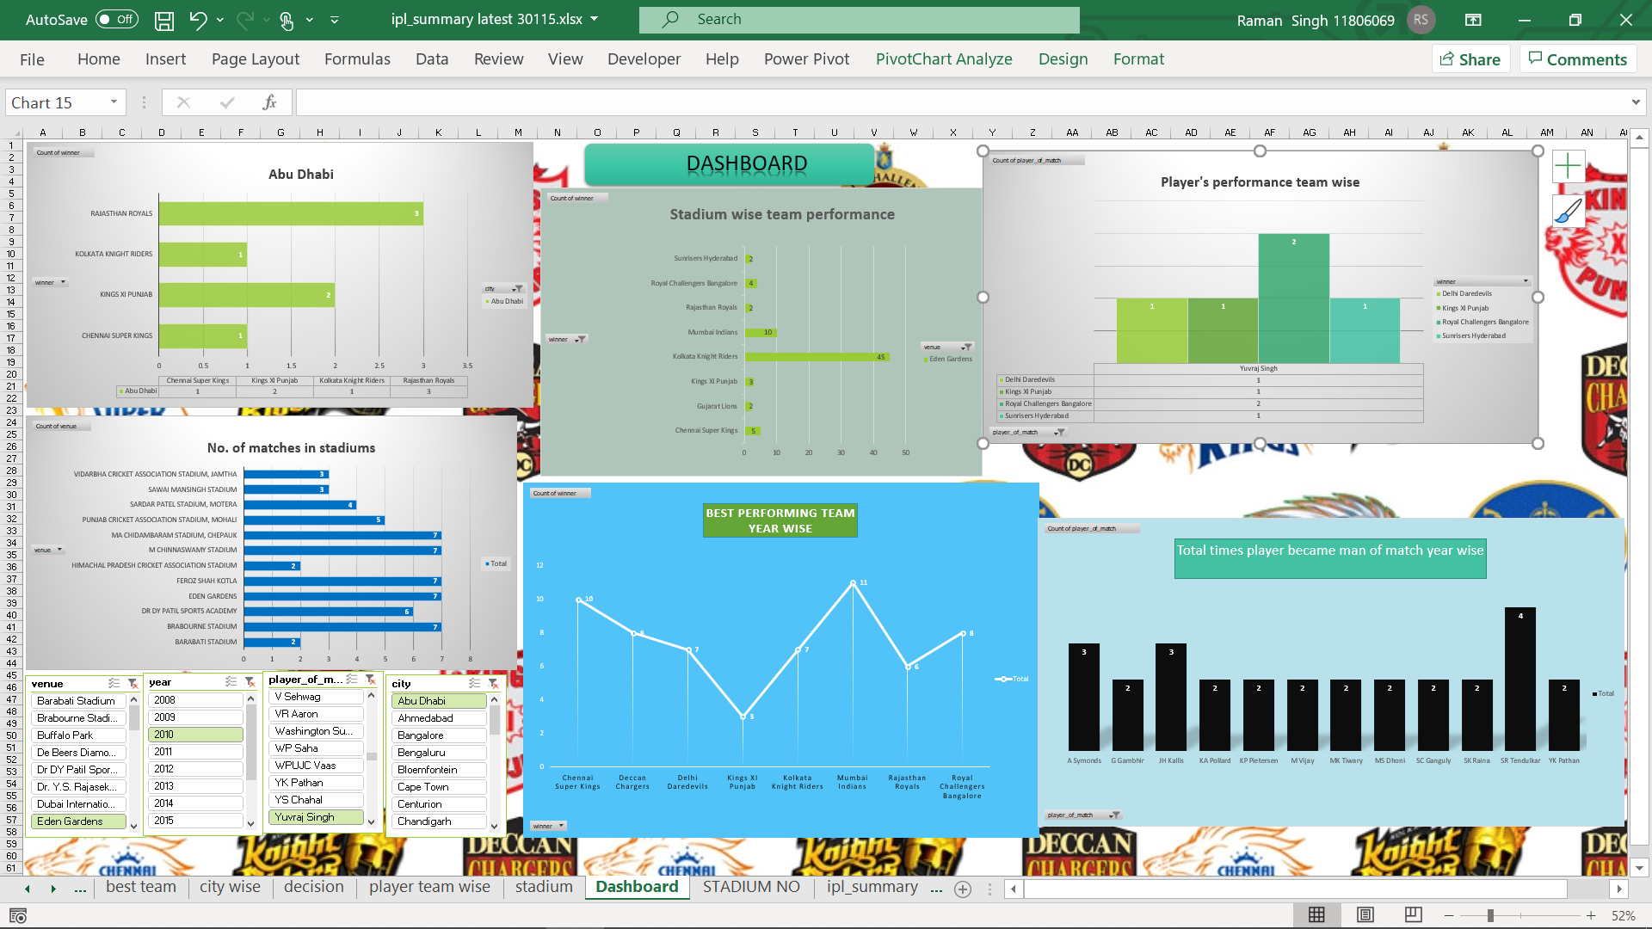

Slide 15



THANK YOU

